Slide 2
WHAT IS MACHINE LEARING?
Ability of a machine to improve its own performance through the use of software that employs artificial intelligence techniques to mimic the ways by which humans seem to learn, such as repetition and experience.

Slide 3
LEARNING FROM DATA
Data is recorded from some real-world phenomenon.
What might we want to do with that data?
Prediction: What can we predict about this phenomenon?
Description: How can we describe/understand this phenomenon in a new way?

Slide 4
Types of problems
Supervised learning :
Training data includes both the input and desired results.
Reinforcement learning :
It is learning from interaction with an environment ; from the consequences of action, rather than from explicit teaching.
Unsupervised learning
The data have no target attribute.
find some intrinsic structures in them ; the model is not provided with the correct result during the training.

Slide 5
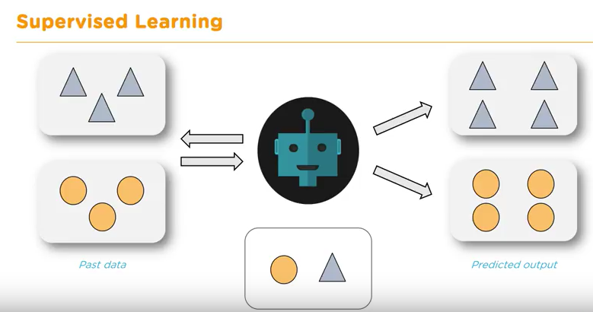
Supervised Learning
A model is able to predict future outcomes

Slide 6
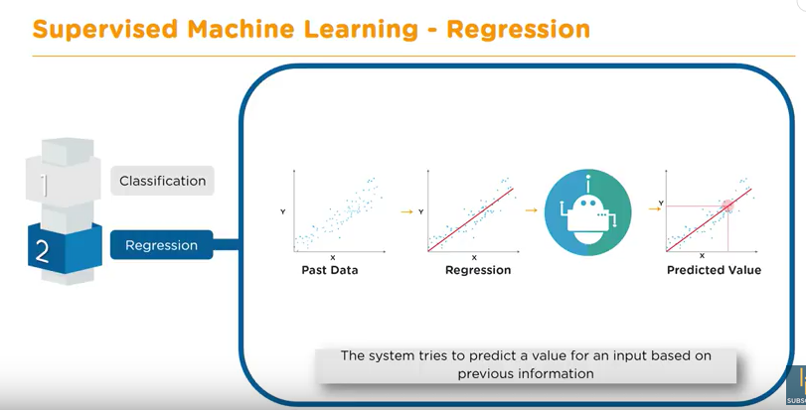

Slide 7
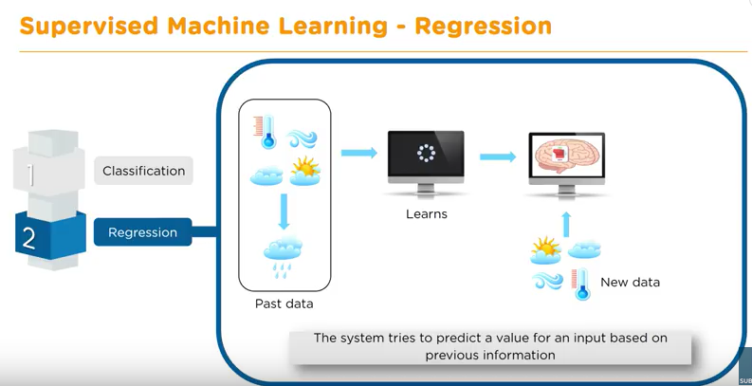

Slide 8
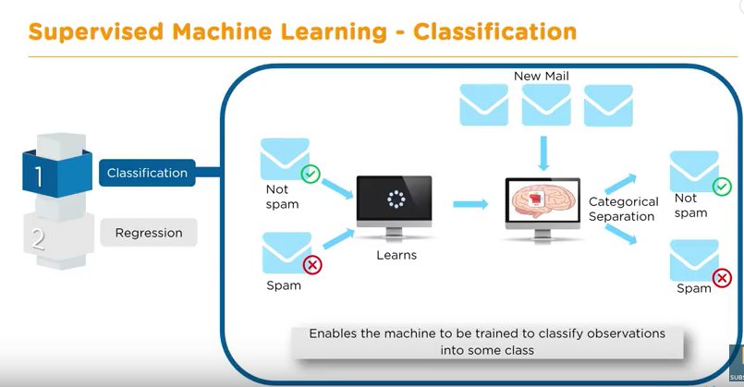

Slide 9
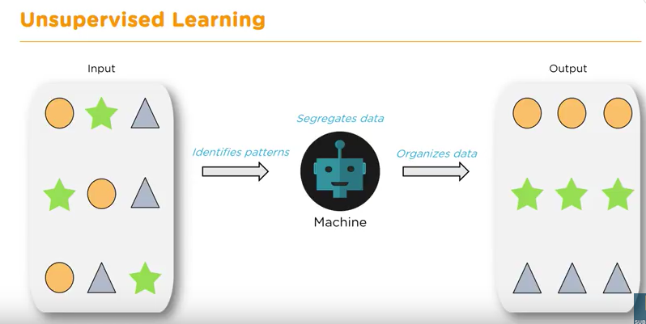
Unsupervised Learning
Find hidden patterns

Slide 10
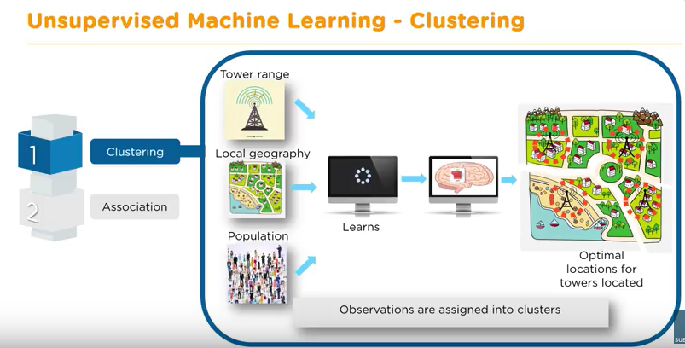

Slide 11
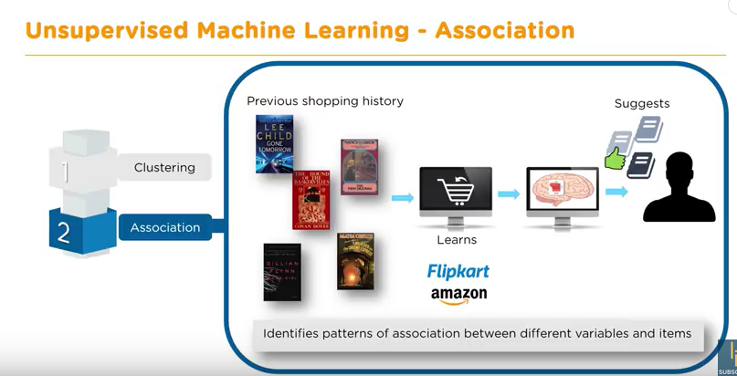

Slide 12
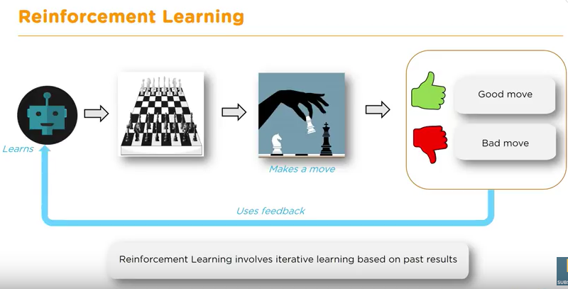
Reinforcement Learning
Source
The system takes decisions based on past rewards for its actions
Proximal Policy Optimization (PPO)

Slide 13
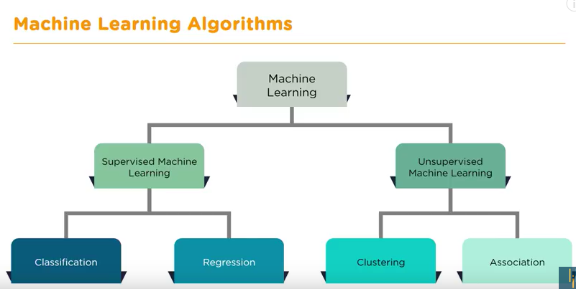

Slide 14
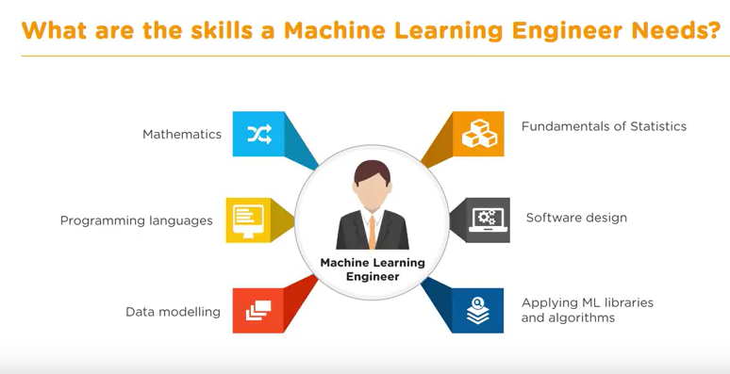

Slide 15
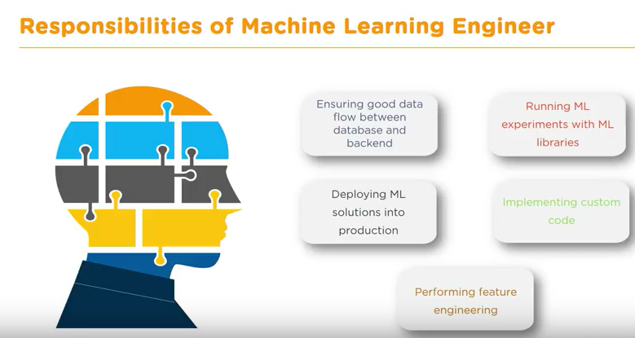

Slide 16
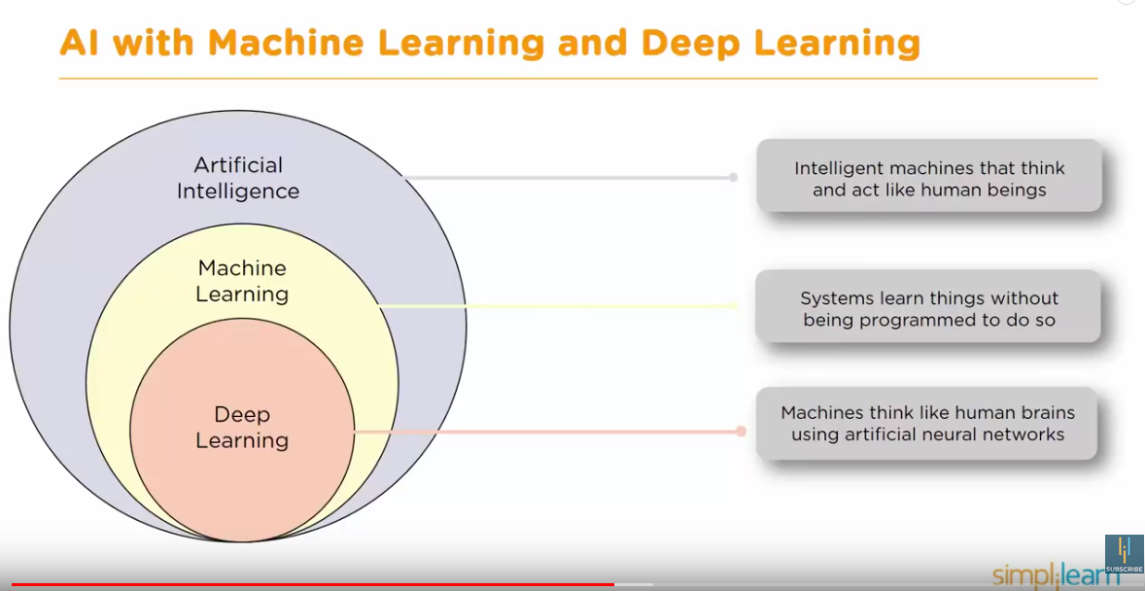
Source

Slide 17
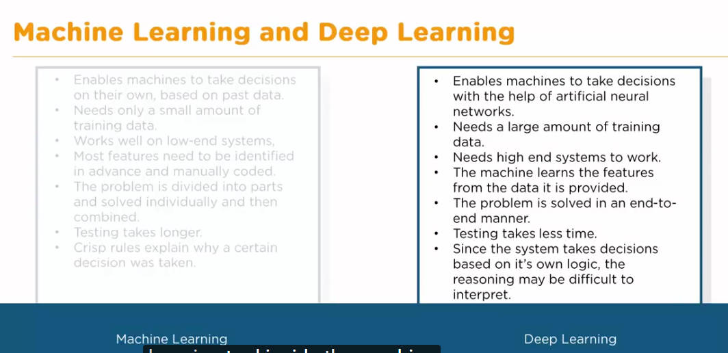

Slide 18
Proximal Policy Optimization A reinforcement learning technique
PPO uses a neural network to approximate the ideal function that maps an agent's observations to the best action an agent can take in a given state.
https://github.com/Unity-Technologies/ml-agents/blob/master/docs/Training-PPO.md

Slide 19
Training Intelligent Agents
The actions of the agent change the state of the environment.
The environment provide the agent with rewards.
State & Reward
Environment
Agent
Action

Slide 20
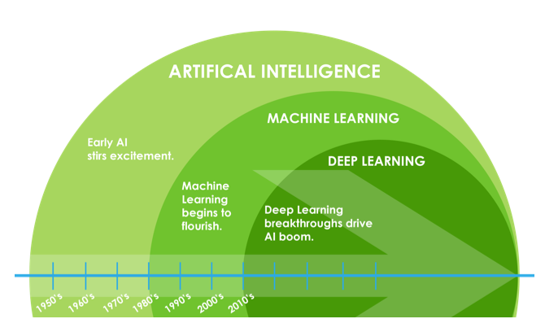
Difference Between Artificial Intelligence Machine Learning and Deep Learning.
Source
Notes:
Deep Learning is Subset of Machine Learning and Machine Learning is subset of Artificial Intelligence.
As the time evolved the Parent (Artificial Intelligence) got sub-grouped into Machine Learning And Deep Learning.

Slide 21
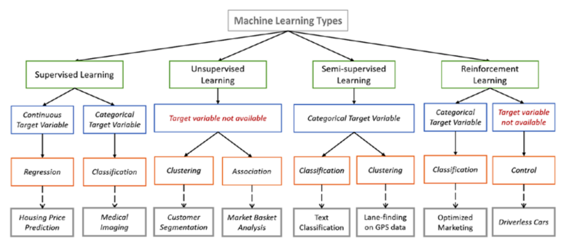

Slide 22
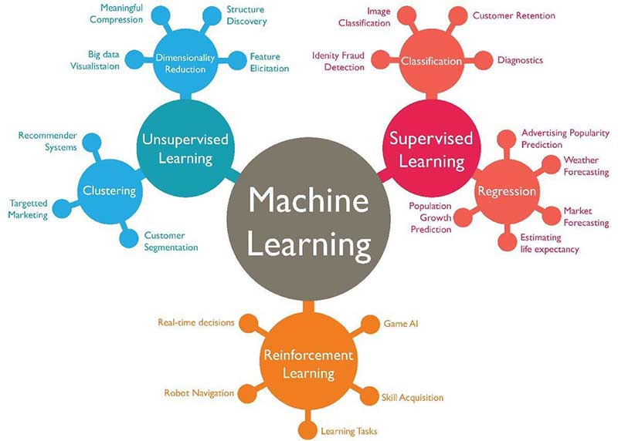
Machine Learning Algorithm - Backbone of emerging technologies

